Slide 1
SHAFEEQUR REHMAN MOHAMMED
EMPLOYEE ID: 152992
JEE FULL STACK, MIPL

Slide 2
CapStore Shopping Application

Slide 3
Project Requirements

Slide 4
Softwares:
Java 10
STS Version: 3.9.4.RELEASE
MySQL 5.5 Command Line Client
HTML 5
CSS 3
BootStrap
JavaScript
JSP
Spring Boot (2.0.4)
Spring Rest
Notes:
Fixar a posicao do titulo – sempre do lado esquerdo.
Sempre que tiver muito texto o coluna deve sempre ser “ narrowed” , se nao fica dificil de ler. Colocar paragrafos no texto.
Linha vertical deve ser mais fina e as pontas NUNCA devem ser arredondadas.

Slide 5
MODULE
PLACING THE ORDER

Slide 6
Placing the Order
The customer is on the product page and wishes to place an order for the selected product.
If the product is not available in the inventory, out of stock alert is prompted.
The customer either clicks on BUY NOW button or ADDs TO CART for the selected product.
If the customer wishes to BUY instantly, he/she is navigated to the shipping details page allowing him/her to give the shipping address details.
Prior to this, an Order Id is auto-generated for the purchased product, which is used for accessing the product details in future.
If the transaction is found to be successful, a Transaction Id is auto-generated.
Using this transaction Id, the inventory is updated.

Slide 7
Placing the Order (Contd..)
If the customer wishes to ADD the product TO CART, he/she is navigated to the cart page.
Here the customer sets the quantity and clicks on Check-Out button and is navigated to the shipping details page.
Again an Order Id is auto-generated for the purchased product, which is used for accessing the product details in future.
If the transaction is found to be successful, a Transaction Id is auto-generated.
Using this transaction Id, the inventory is updated.

Slide 8
Tables Used
Inventory
productId
category
dateOfInclusion
description
expiryDate
noOfViews
Price
productName
quantity
brandId
couponId
discountId
invoiceProductId
merchantId
ManagingCart
cartId
quantity
status
customerId
productId
orderId
Order
orderId
deliveredDate
deliveryStatus
orderDate
customer
Transaction
transactionId
amount
modeOfPurchase
status
transactionDate
orderId

Slide 9
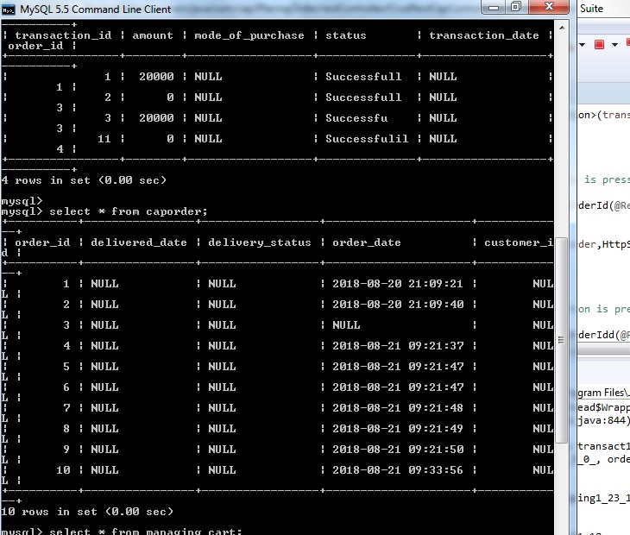
Generation of Order ID

Slide 10
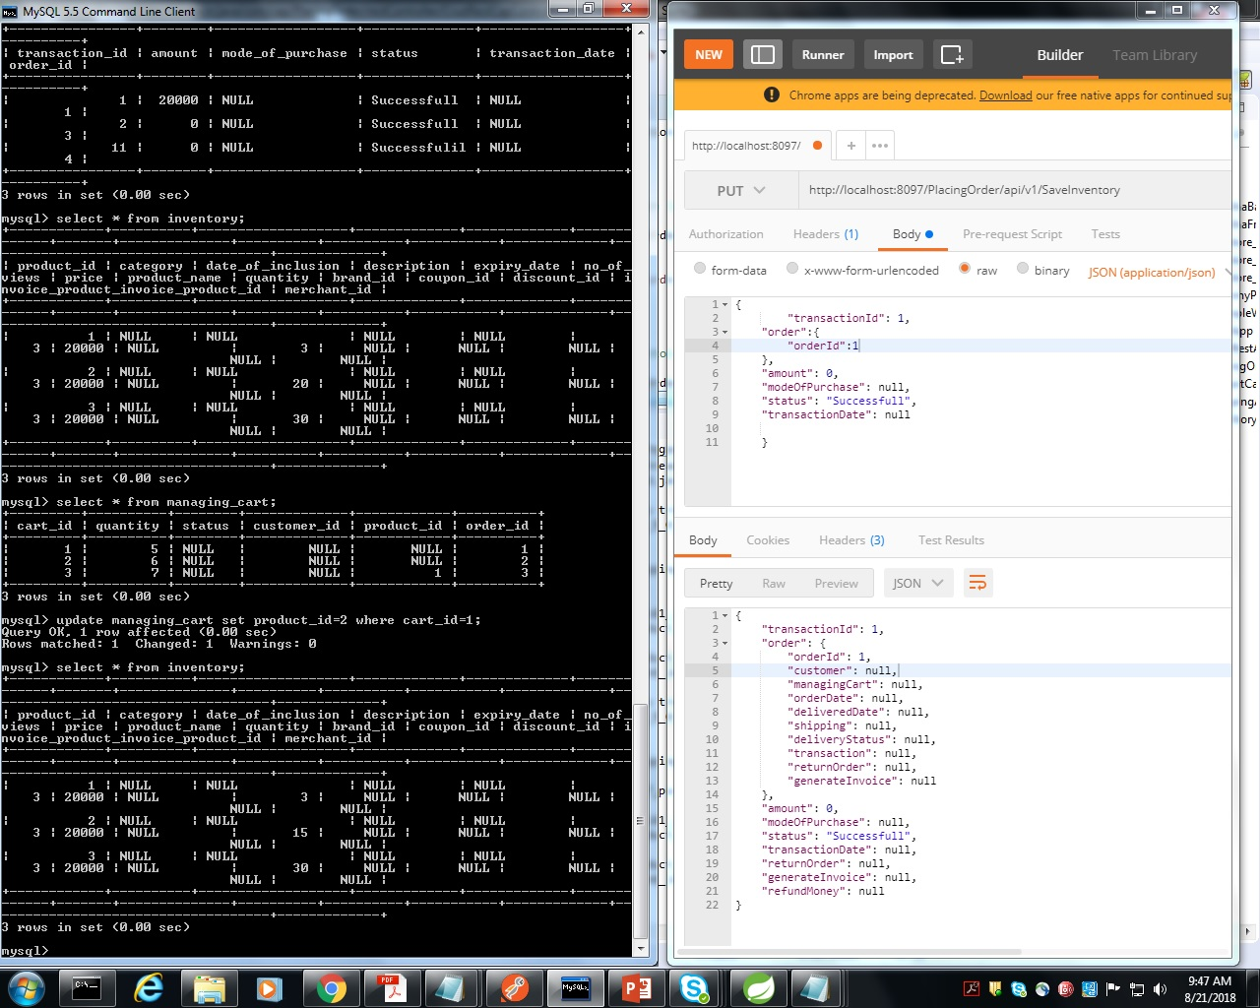
Updating the Inventory

Slide 11
Thank You
Notes:
O Box atras do texto desnecessario. Deixar o layout mais simples.

